Slide 1
Portable Class Libraries

Slide 2
The Novice
Assembly 1
UI Code
Business Logic
Data Code

Slide 3
Separation of Concerns
Assembly 1
Assembly 1
Assembly 2
Assembly 3
UI Code
UI Code
Business Logic
Data Access Code
Business Logic
Data Code

Slide 4
Code Reuse
Assembly 1a
Windows Forms
.NET 3.0 Library
Assembly 2
UI Code
Business Logic
Assembly 1b
ASP.NET
UI Code

Slide 5
Compatibility Issues
Assembly 1a
Windows Forms
.NET 3.0 Library
Assembly 2
UI Code
Business Logic
Assembly 1b
ASP.NET
Silverlight
UI Code

Slide 6
Compatibility Issues
Windows 8
Assembly 1a
Assembly 1c
Windows Forms
.NET 3.0 Library
Assembly 2
UI Code
UI Code
Business Logic
Windows Phone
Assembly 1b
Assembly 1c
ASP.NET
Silverlight
UI Code
UI Code

Slide 7
Compatibility Issues
Windows 8
Assembly 1a
Portable Class Library
Assembly 1c
Windows Forms
.NET 3.0 Library
Assembly 2
Assembly 2
UI Code
UI Code
Business Logic
Business Logic
Windows Phone
Assembly 1b
Assembly 1c
ASP.NET
Silverlight
UI Code
UI Code

Slide 8
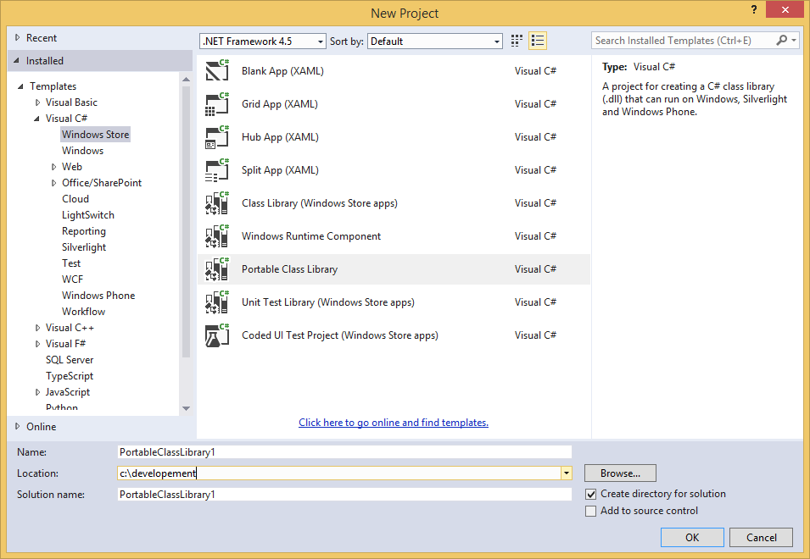
Creating a Portable Class Library

Slide 9
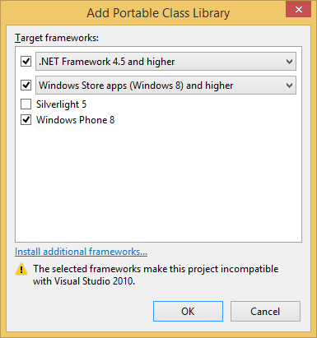
Creating a Portable Class Library

Slide 10
Cross-Platform Cloud Kit

Slide 11
Download from Github
tinyurl.com/XPlatformCloudKit

Slide 12
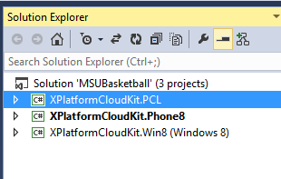
Projects

Slide 13
Projects
Phone
Win8
PCL
AppSettings.cs

Slide 14
AppSettings.cs
Global Options
Azure Mobile Services
RSS
Local Items
Windows 8 Project Options
Windows Phone Project Options
Youtube Video Link Options
Advanced ItemDescriptionView / Webview Options

Slide 15
Phone
Properties\WMAppManifest.xml

